Slide 1
CSE 1102 Fundamentals of Programming Lecture #5
Spring 2017
Computer Science & Engineering Program
School of Electrical Engineering & Computing
Adama Science & Technology University

Slide 2
I/O statements and functions
Using Library Functions
Formatting Numbers for Program Output
Mathematical Library Functions
Input using the cin object
Symbolic Constants
Writing Functions
Function and parameter declarations
Returning a value
Pass by Value and Pass by Reference
Variable Scope and Lifetime
Case Study: (Chemistry) Acid Rain
(General Math) Length Conversion
(General Math) Rectangular to Polar Coordinate Conversion
Reading assignment
Chapter 3 of the textbook
Chapter 6 of the textbook
Read about
Function Overloading
Default Arguments

Slide 3
Formatting Numbers for Program Output
Proper output formatting contributes to ease of use and user satisfaction
cout with stream manipulators can control output formatting
Manipulator | Action
setw (n) | Set the field width to n
scientific | Set the output to display real numbers in scientific notation
endl | Output a newline character and display all characters in the buffer
fixed | Always show a decimal point and use a default of six digits after the decimal point. Fill with trailing zeros, if necessary.
setprecision(n) | Set the floating-point precision to n places.

Slide 4
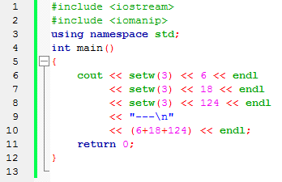
Formatting Numbers for Program Output

Slide 5
Formatting Numbers for Program Output
The field width manipulator must be included for each value in the data stream sent to cout
Other manipulators remain in effect until they are changed
iomanip header file must be included to use manipulators requiring arguments

Slide 6
Formatting Numbers for Program Output
Formatting floating-point numbers requires three field-width manipulators to:
Set the total width of the display
Force a decimal place
Set the number of significant digits after the decimal point
Example:
cout << "|" << setw(10) << fixed
<< setprecision(3) << 25.67 << "|";
produces this output: | 25.670|

Slide 7
Using Mathematical Library Functions
C++ has preprogrammed mathematical functions that can be included in a program
You must include the cmath header file:
#include <cmath>
Math functions require one or more arguments as input, but will return only one value
All functions are overloaded, and can be used with integer and real arguments

Slide 8
Using Mathematical Library Functions

Slide 9
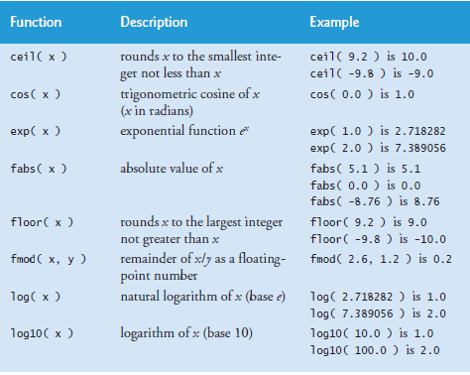

Slide 10
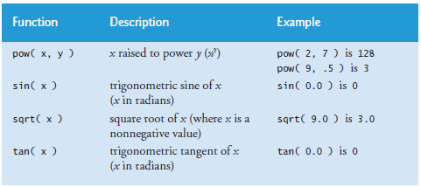

Slide 11
Using Mathematical Library Functions
To use a math function, give its name and pass the input arguments within parentheses
Expressions that can be evaluated to a value can be passed as arguments

Slide 12
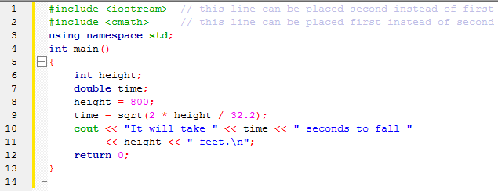
Using Mathematical Library Functions

Slide 13
Program Input Using cin
cin Object: Allows data entry to a running program
Use of the cin object causes the program to wait for input from the keyboard
When keyboard entry is complete, the program resumes execution, using the entered data
An output statement preceding the cin object statement provides a prompt to the user

Slide 14
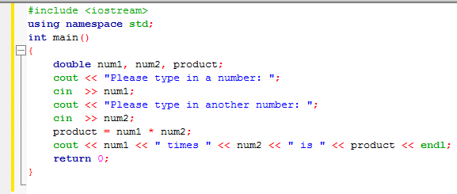
Program Input Using cin

Slide 15
Program Input Using cin
cin can accept multiple input values to be stored in different variables
Multiple numeric input values must be separated by spaces
Example:
cin >> num1 >> num2
with keyboard entry: 0.052 245.79

Slide 16
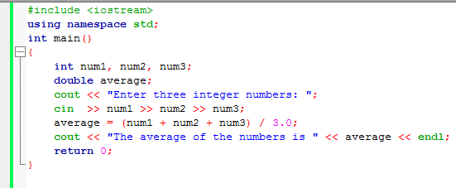
Program Input Using cin

Slide 17
Program Input Using cin
User-input validation: The process of ensuring that data entered by the user matches the expected data type
Robust program: One that detects and handles incorrect user entry

Slide 18
Case Study: Acid Rain
Currently, coal is one of the principal sources of electrical power generation in many industrialized countries.
it is known that the oxygen used in the burning process combines with the carbon and sulfur in coal to produce carbon dioxide and sulfur dioxide.

Slide 19
Case Study: Acid Rain
When these gases are released into the atmosphere, sulfur dioxide com-bines with water and oxygen in the air to form sulfuric acid
Then it is transformed into separate hydronium ions and sulfates see figure.
The hydronium ions in the atmosphere that fall to Earth as components of rain are what change the acidity levels of lakes and forests

Slide 20
Case Study: Acid Rain

Slide 21
Case Study: Acid Rain
The acid level of rain and lakes is measured on a pH scale by using this formula:
$$pH=−\log_{10}\left(concentration of hyrodnium ions\right)$$

Slide 22
Case Study: Acid Rain
The concentration of hydronium ions is measured in units of moles/liter.
pH value 7 =>neutral value
pH below 7 =>acid,
pH above 7=>alkaline
Marine life usually can’t survive in water with a pH level below 4.

Slide 23
Case Study: Acid Rain
Using the formula for pH, we will write a C++ program, using the software development procedure described in Lecture 1,

Slide 24
Case Study: Acid Rain
Acid Rain: Develop a program to calculate the pH level of a substance based on user input of the concentration of hydronium ions
Step 1: Analyze the Problem
Step 2: Develop a Solution
Step 3: Code the Solution
Step 4: Test and Correct the Program

Slide 25
Step 1: Analyze the Problem
Although the problem statement provides technical information on the composition of acid rain, from a programming viewpoint, this problem is rather simple.
You have only one required output (a pH level) and one input (the concentration of hydronium ions).

Slide 26
Step 2: Develop a Solution
Display a prompt to enter an ion concentration level
Read a value for the concentration level
Calculate a pH level, using the given formula
Display the calculated value

Slide 27
Step 3: Code the Solution

Slide 28
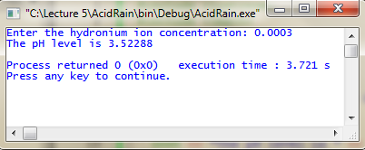
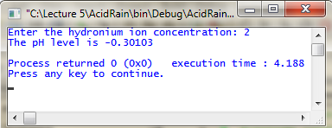
Step 4: Test and Correct the Program
First test
Second test
Think about validating the user input so that the pH level becomes between 0 and 14
We need selection statements

Slide 29
Symbolic (Named) Constants
Symbolic constant: Constant value that is declared with an identifier using the const keyword
A constant’s value may not be changed
Example:
const int MAXNUM = 100;
Good programming places statements in appropriate order

Slide 30
Case Study: Length Conversion
Length Conversion: Write a program that takes as input given lengths expressed in feet and inches. The program should then convert and output the lengths in centimeters. Assume that the given lengths in feet and inches are integers.
Step 1: Analyze the Problem
Step 2: Develop a Solution
Step 3: Code the Solution
Step 4: Test and Correct the Program

Slide 31
Step 1: Analyze the Problem
The lengths are given in feet and inches, and we need to find the equivalent length in centimeters.
Input: Length in feet and inches.
Output: Equivalent length in centimeters.

Slide 32
Step 2: Develop a Solution
Get the length in feet and inches.
Convert the length into total inches.
Convert the feet into inches
Multiply the number of feet by 12
Add the given inches
Convert total inches into centimeters.
Multiply the total inches by 2.54
Output centimeters.

Slide 33
Step 3: Coding

Slide 34
Function and Parameter Declarations
Interaction with a function includes:
Passing data to a function correctly when its called
Returning values from a function when it ceases operation
A function is called by giving the function’s name and passing arguments in the parentheses following the function name

Slide 35
Before a function is called, it must be declared to function that will do calling
Declaration statement for a function is referred to as function prototype
Function prototype tells calling function:
Type of value that will be formally returned, if any
Data type and order of the values the calling function should transmit to the called function
Function prototypes can be placed with the variable declaration statements above the calling function name or in a separate header file

Slide 36
Calling a Function
Requirements when calling a function include:
Using the name of the function
Enclosing any data passed to the function in the parentheses following the function name, using the same order and type declared in the function prototype

Slide 37
Calling a Function
The items enclosed in the parentheses are called arguments of the called function

Slide 38
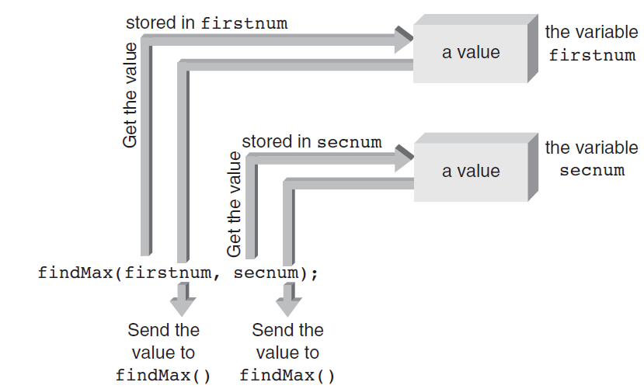
Calling a Function

Slide 39
Defining a Function
Every C++ function consists of two parts:
Function header
Function body
Function header’s purpose:
Identify data type of value function returns, provide function with name, and specify number, order, and type of arguments function expects
Function body’s purpose:
To operate on passed data and return, at most, one value directly back to the calling function

Slide 40
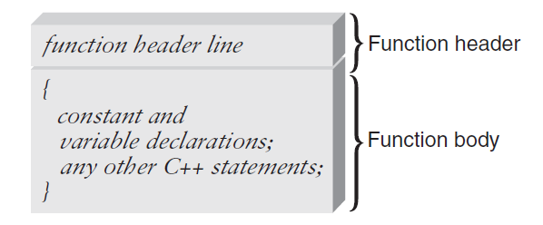
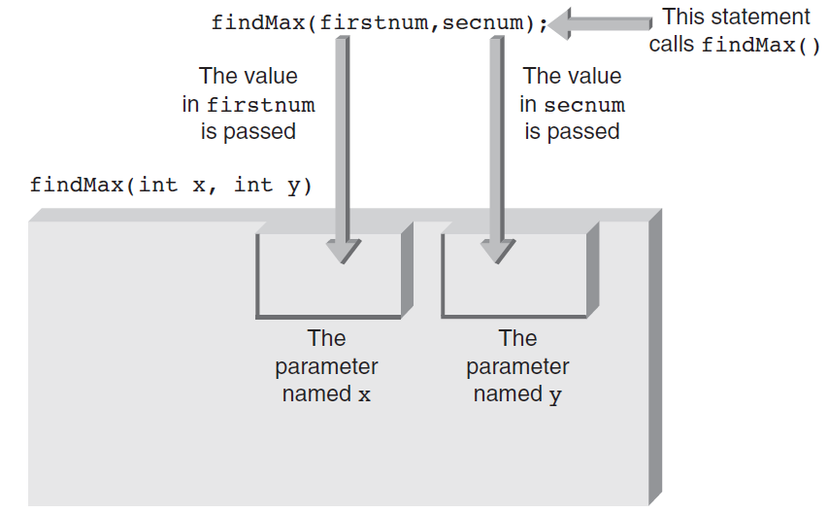
Defining and Calling Functions

Slide 41
Placement of Statements
General rule for placing statements in a C++ program:
All preprocessor directives, named constants, variables, and functions must be declared or defined before they can be used
Although this rule permits placing both preprocessor directives and declaration statements throughout the program, doing so results in poor program structure

Slide 42
Empty Parameter List
Although useful functions having an empty parameter list are extremely limited, they can occur
Function prototype for such a function requires writing the keyword void or nothing at all between the parentheses following the function’s name
Examples:
int display();
int display(void);

Slide 43
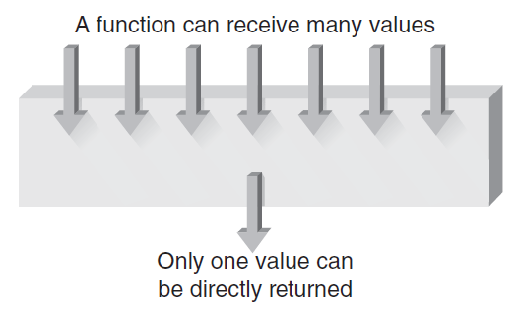
Returning a Value
Function receiving an argument passed by value cannot inadvertently alter value stored in the variable used for the argument
Function receiving passed by value arguments can process the values sent to it in any fashion and return one, and only one, “legitimate” value directly to the calling function

Slide 44
Pass By Value and Pass By Reference
In a typical function invocation, called function receives values from its calling function, stores and manipulates the passed values, and directly returns at most one value
Pass by value: When data is passed in this manner
Pass by reference: Giving a called function direct access to its calling function’s variables is referred to as
The called function can reference, or access, the variable whose address has been passed as a pass by reference argument

Slide 45
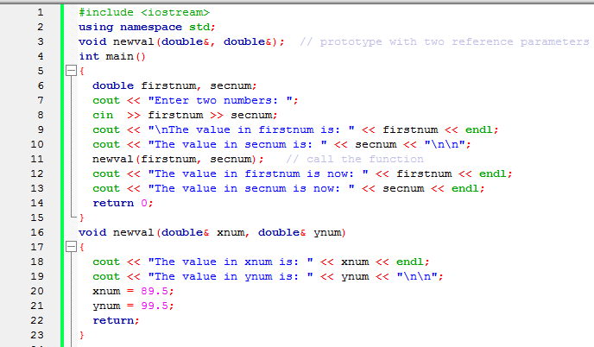
Pass By Value and Pass By Reference

Slide 46
Pass By Value and Pass By Reference
From the sending side(caller)
calling a function and passing an address as an argument that’s accepted as a reference parameter is the same as calling a function and passing a value
Whether a value or an address is actually passed depends on the parameter types declared
Address operator (&) provides the variable’s address

Slide 47
Pass By Value and Pass By Reference

Slide 48
Pass By Value and Pass By Reference

Slide 49
Pass By Value and Pass By Reference

Slide 50
Case Study: Rect. to Polar Coord. Conversion
We follow Top Down Design and Step-wise refinement
This initial outline begins the process of defining a more complicated problem as a set of smaller, more manageable tasks.
Each of these tasks can be further subdivided or refined into even smaller tasks, if required.
After the tasks are well defined, the actual work of coding can begin, starting with any task in any order.

Slide 51
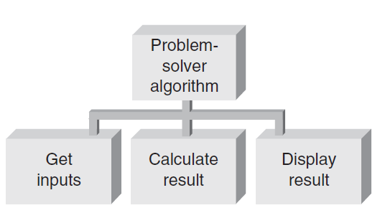
Case Study: Rect. to Polar Coord. Conversion
Top Level Algorithm

Slide 52
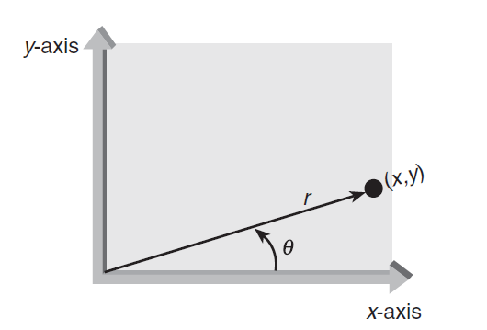
Step 1: Define a Problem
Correspondence between polar(distance and angle) and Cartesian(x and y) coordinate

Slide 53
Step 1: Define a Problem
When the x- and y-coordinates of a point are known, the equivalent r and θ coordinates can be calculated by using these formulas
$$r=\sqrt{x^{2}+y^{2}}$$
$$θ=\tan^{−1}\left(y/x\right);x≠0$$

Slide 54
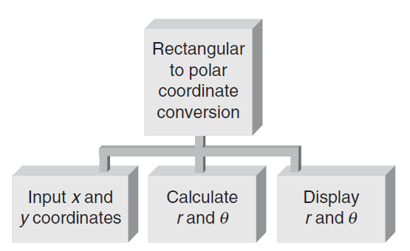
Step 1: Define a Problem
Top Level Structure(Initial Pseudo Code)
Get the x- and y-coordinate values
Calculate the polar (r and θ) coordinate values
Display the polar coordinate values

Slide 55
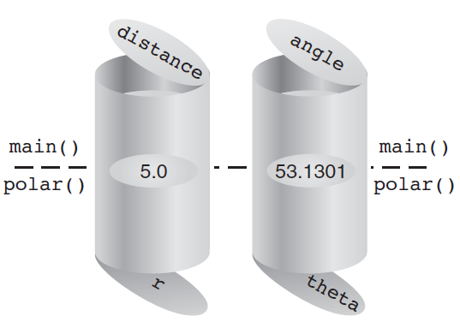
Step 1: Define a Problem
Initial Coding

Slide 56
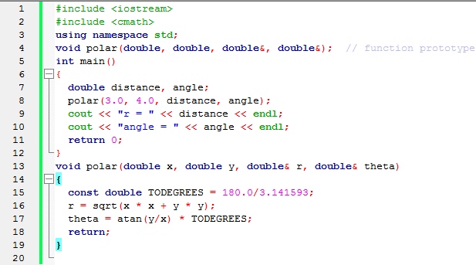
Step 2: Test the Function
After polar() is written, it can be tested independently of any other function.
r=5
angle=53.1301

Slide 57
Step 3: Complete the Program
The program also requires
writing functions for accepting two rectangular coordinates
The following function, getrec() , can be used to accept the input data
Test it
displaying the calculated polar coordinates
The function showit() for displaying polar coordinates is constructed in a similar manner.
Test it

Slide 58
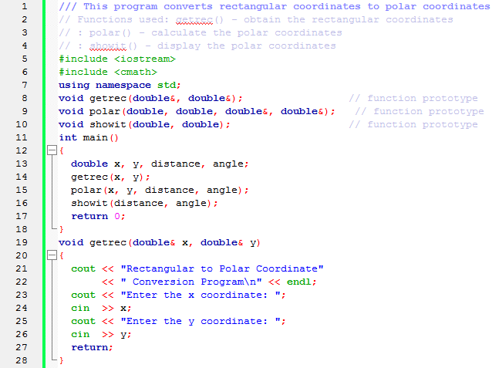
The Complete Program

Slide 59
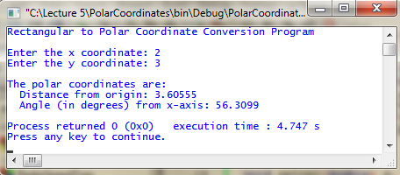
The Complete Program

Slide 60
Variable Scope
Local variables: Variables created in a function that are conventionally available only to the function
Scope: Section of the program where the identifier is valid or “known”
A variable with local scope is simply one with storage locations set aside for it by a declaration statement inside the function that declared them
A variable with global scope has storage created for it by a declaration statement located outside any function

Slide 61
Variable Scope

Slide 62
Variable Scope
When a local variable has the same name as a global variable, all references to the variable name made within the local variable’s scope refer to the local variable

Slide 63
Scope Resolution Operator
To reference a global variable when a local variable of the same name is in scope, use C++’s scope resolution operator, which is ::

Slide 64
Misuse of Globals
Global variables allow programmers to “jump around” the normal safeguards provided by functions
Instead of passing variables to a function, it is possible to make all variables global: do not do this
Indiscriminate use of global variables destroys the safeguards C++ provides to make functions independent and insulated from each other
Using only global variables can be especially disastrous in large programs with many user-created functions

Slide 65
Lifetime of Variables
A variable’s scope can be thought of as the space in the program where the variable is valid
In addition to space dimension represented by scope, variables have a time dimension that refers to the length of time storage locations are reserved for a variable
This time, dimension is referred to as the variable’s lifetime
When and how long a variable’s storage locations are kept before they are released can be determined by the variable’s storage category

Slide 66
Variable Storage Categories
The four available storage categories are:
auto
static
extern
register

Slide 67
Local Variable Storage Categories
Local variables can be members only of the auto, static, or register storage categories
Storage for automatic local variables is reserved or created automatically each time a function is called
As long as the function hasn’t returned control to its calling function, all automatic variables local to the function are “alive”
A local static variable isn’t created and destroyed each time the function declaring it is called
Local static variables remain in existence for the program’s lifetime

Slide 68
Local Automatic Variable

Slide 69
Local Static Variable

Slide 70
Global Variable Storage Categories
Global variables are created by definition statements external to a function
By their nature, global variables do not come and go with the calling of a function
After a global variable is created, it exists until the program in which it’s declared has finished executing
Global variables can be declared with the static or extern storage category, but not both

